Slide 1

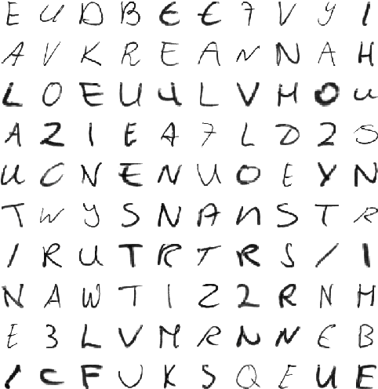
MNIST and Machine Learning
Recognising Handwritten Alphabets

Slide 2
Tasks to perform on MNIST Image dataset
▪ Unzip the data.
▪ Create a dataframe.
▪ Convert the image data into numerical data.
▪ Apply ML algorithms on the numerical data.
▪ Predict and Evaluate the models.
▪ Compare the models and their Evaluation scores.

Slide 3



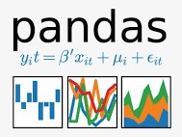




Libraries used
02
import OS
from PIL import Image
import numpy as np
import pandas as pd
import time
import seaborn as sns
import matplotlib.pyplot as plt
import sklearn

Slide 4
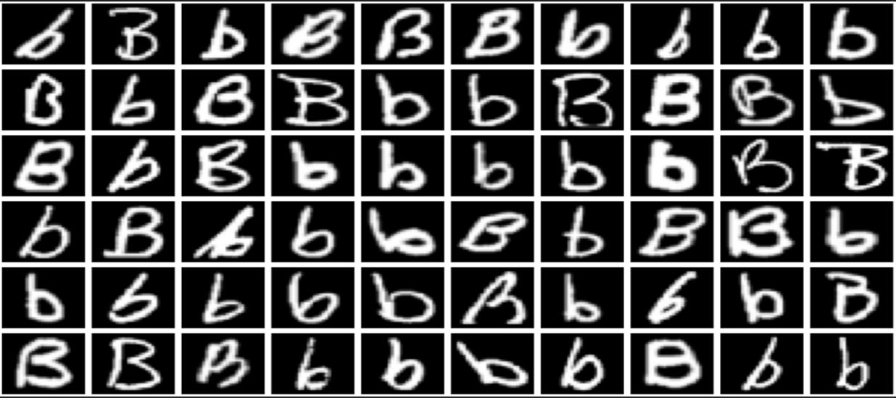

Data before Dataframe
▪ Extraction of 26 Classes of Image Data from Zipped folder.
▪ Data Observation of Class “B” Data.

Slide 5
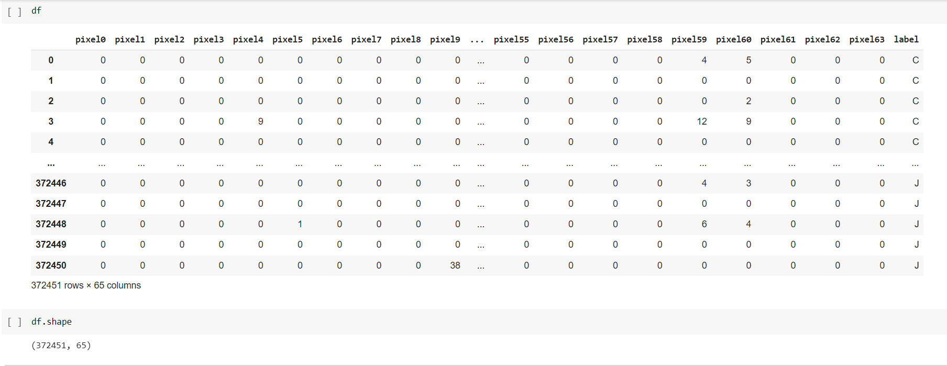
Dataset as Dataframe
Resizing the shape of image pixels to (8,8) size, i.e, range(0,64).
Converting the image data into numpy array by using flattening technique(ravel()) and representing/ storing them in a data frame.

Slide 6
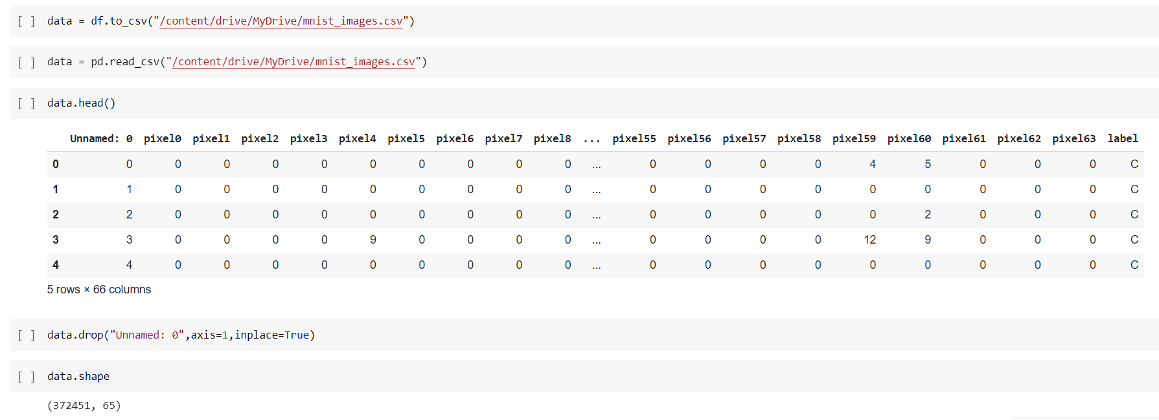
Transformation of Data to tabular format (.csv)
Transforming the data frame into a csv file, so that we can read it whenever we want.

Slide 7
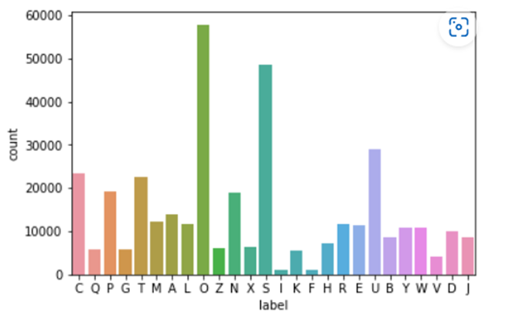
Parts of the lesson
Understanding the data
Data contains:
A,B,C,D,E,F,G,H,I,J,K,L,M,N,O,P,Q,R,S,T,U,V,X,Y,Z
Features:
372451 rows
and
65 columns
Earth

Slide 8
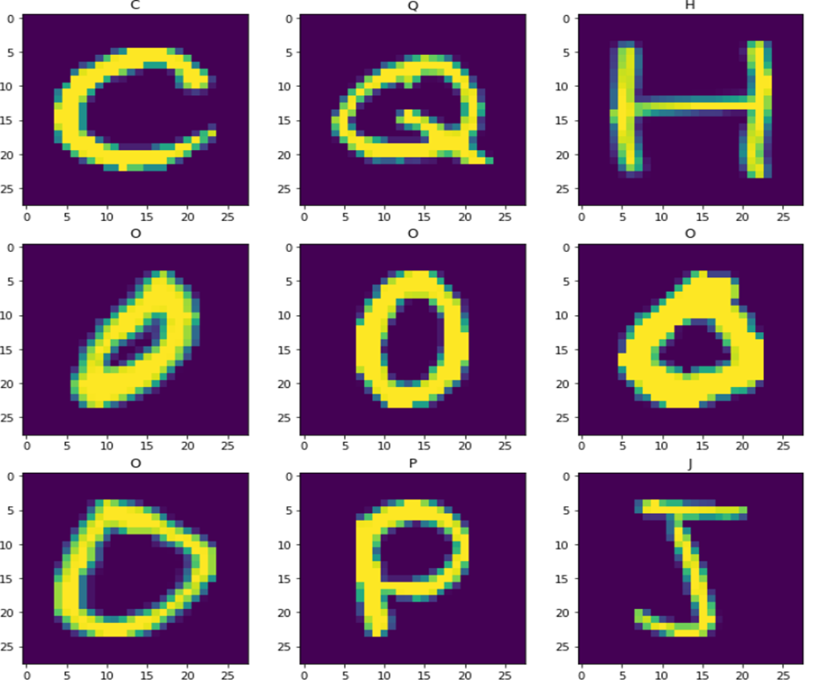

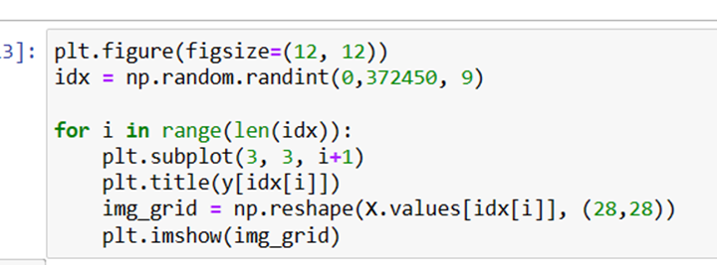
Image View combination
Pixel conformation of IMAGE’S

Slide 9
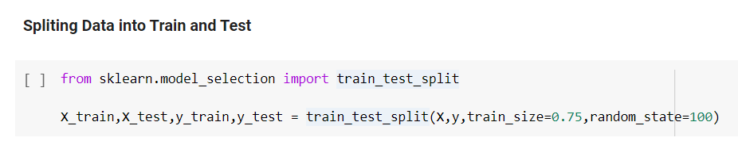
Train-Test split
Split of 75:25
—Someone Famous

Slide 10
Classification algorithms to build a Model
Logistic Regression
KNN Classification
Decision Tree Classification
Naive Bayes Classification
Random Forest Classification
ADABoost Classification

Slide 11
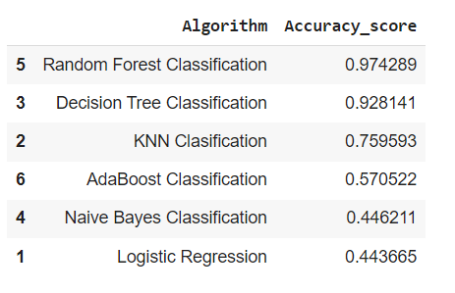
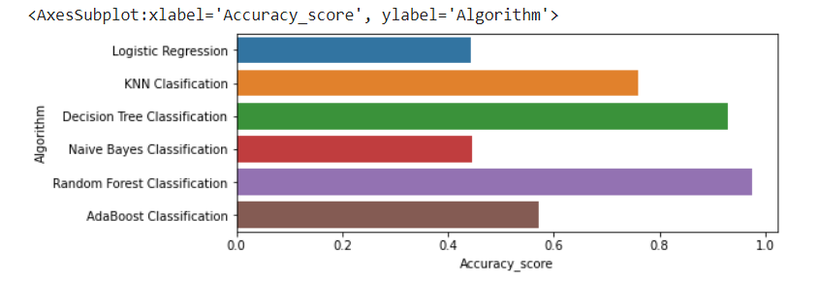
Accuracy results
Saturn
Mars
Saturn is a gas giant and has rings
Despite being red, it’s a cold place
Jupiter
Ceres
Venus
It’s the biggest planet in the Solar System
Ceres is located in the main asteroid belt
Venus is the second planet from the Sun
Random Forest has achieved highest accuracy with 97.4% and Decision Tree is 92.8% whereas Logistic Regression and Naive Bayes algorithms achieved least accuracy with 44%.

Slide 12
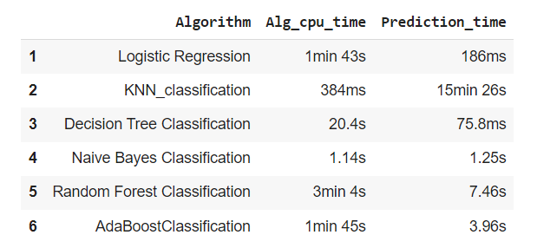
Model Building Run time
KNN-classifier has the less CPU time to execute and Random Forest takes more time to execute.
Decision tree classifier takes less time to execute and KNN_classifier takes more time to execute.

Slide 13
Challenges faced
Faced difficulty while unzipping the large dataset.
Had to wait for longer period for the algorithms to predict y_test_pred values, i.e., duration of algorithms’ prediction time was longer than expected.
While iterating the image data in a for loop; to convert it into a data frame, the server got crashed several times since the images were of 786 pixels. But fixed the problem by resizing the image size to 64 pixels.
Less data for some classes (data augmentation is expensive process when applies to large datasets.

Slide 14
Conclusions
With 97.4% of accuracy score, Random Forest Classifier remains as the best algorithm to build this model.
For the users who expect quick response/ prediction, Decision Tree Classifier the best suited algorithm with 75.8ms prediction time and 92.8% accuracy score.
Would not recommend KNN classifier if the user expects quick results, because it’s prediction time is 15min 26s.
This model can recognize text only in English languages, specifically only 26 letter and 0-9 digits.

Slide 15
Thank you!!

